Slide 1








MACHINE LEARNING PROJECT PRESENTATION
Nagamedha Sakhamuri
Panther#: 002828574
MS CS
Notes:
"Good afternoon, everyone. My name is Medha. I am a Computer Science Graduate Student.
"Today, I’ll be presenting my machine learning project, focusing on three different problems

Slide 2
OUTLINE
Objective
Approaches to Solve each Problem
Chosen Methods
Steps Taken
Results
Optimizations & Parameters
Coding Tools & Frameworks
Conclusion
Notes:
"Here is the outline for my presentation.""I’ll start with the objective of the project, followed by the various approaches available to solve the problems.""Next, I’ll explain the chosen methods and why they were selected.""I’ll walk you through the steps taken in each project, highlight the results, and discuss the optimizations and parameters I explored.""I’ll also touch on the coding tools and frameworks used before concluding the presentation."

Slide 3
OBJECTIVE
Apply machine learning techniques to solve three distinct problems
Classification
Missing Value Estimation
Multi-Label Classification
Goal:
Details:
Goal:
Details:
Micro array datasets with varying genes, samples, and percentages of missing values.
Missing values are marked as 1.00000000000000e+99.
The estimated values should improve the quality and completeness of the datasets.
Example:
Input: Dataset with missing values.
Output: A complete dataset with estimated values.
Goal:
Each sample can have multiple labels (marked with 1 in the label matrix).
The prediction output should match the structure of the training labels.
Example:
Output: Predicted labels for test samples in the same format.
Six datasets with varying features, samples, and class distributions.
Missing values (denoted as 1.00000000000000e+99) need to be handled before building the classifier.
The first five datasets involve classification; the sixth involves regression to predict continuous values.
Example:
Input: Training data with labels and a test dataset.
Output: Predicted labels for the test samples.
Assign Single label (class) to each sample in the test dataset based on the patterns learned from the training dataset.
Fill in missing gene expression values accurately.
Details:
A single dataset with 103 features and 14 target labels.
Input: Multi-label training data, labels, and test dataset.
Assign multiple labels to each sample in the test dataset.
Notes:
"The objective of this project is to apply machine learning techniques to solve three problems:
"In this project, I tackled three distinct problems, each requiring a unique approach."
Classification:
"This involves assigning a single label to each test sample."
"The datasets vary in size, features, and classes, and we handle missing values before classification."
given training data and test data, we predict test labels
Missing Value Estimation:
"The focus here is on predicting and filling missing gene expression values in microarray data."
"Missing values are replaced with estimates based on other available data."
"For instance, missing gene values are predicted using KNN or Mean Imputation."
Multi-Label Classification:
"This involves assigning multiple labels to each test sample."
"For example, a single sample might belong to categories such as 'Dog' and 'Plant'."

Slide 4
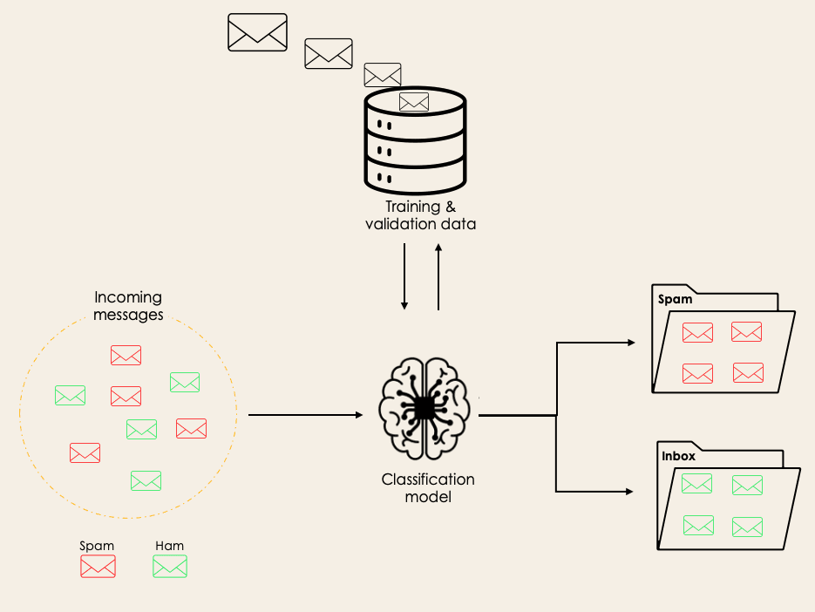
CLASSIFICATION
Assign a single label to samples.
Example: Spam detection.
Possible Approaches | Chosen Methods & Significance
Random Forest MLP Gradient Boosting SVM Logistic Regression | Random Forest: Handles missing values and non-linear relationships. MLP: Effective for high-dimensional and complex data.
Steps
Data Preparation: Handle missing values, normalize features. Model Selection: Choose Random Forest, MLP. Training: Train models using training data. Prediction: Predict labels for test data.
Notes:
"Classification involves assigning a single label to each sample. A simple example is spam detection, where emails are classified as 'Spam' or 'Not Spam.’”
"The diagram visually shows how a classification model processes incoming data to produce labeled outputs, such as filtering spam emails into a dedicated folder."
"There are several possible approaches to solving classification problems, including Random Forest, MLP, Gradient Boosting, SVM, and Logistic Regression."
"For this project, I chose Random Forest and MLP for their respective strengths: Random Forest handles missing values and non-linear relationships effectively, while MLP works well with high-dimensional and complex data."
"The steps for solving classification include:"
"Data Preparation: Handling missing values and normalizing features."
"Model Selection: Choosing appropriate methods like Random Forest or MLP."
"Training: Training the models using the labeled data."
"Prediction: Using the trained models to predict labels for test data."

Slide 5
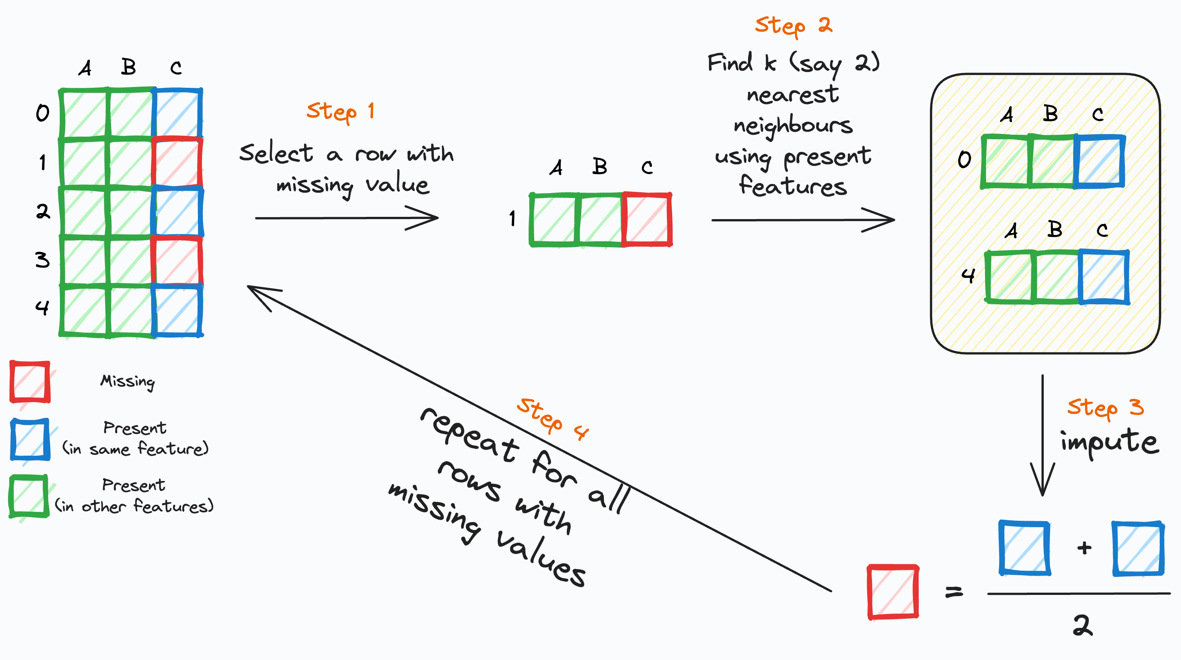
MISSING VALUE ESTIMATION
Example: Predict gene expression values.
Predict and fill missing values in datasets.
Possible Approaches | Chosen Methods & Significance
Mean/Median Imputation KNN Imputation MICE Matrix Factorization | KNN Imputation: Captures relationships between features. Mean Imputation: Simple and fast.
Steps
Identify Missing Values: Replace placeholders with NaN. Imputation: Fill missing values using KNN or Mean Imputation. Evaluation: Check completeness of the imputed dataset.
Notes:
"Missing value estimation involves predicting and filling missing values in datasets."
"A common example is predicting gene expression values where some data points are missing."
"The diagram visually represents how missing values are filled step-by-step using KNN Imputation, emphasizing how the nearest neighbors contribute to filling gaps."
"Possible approaches include Mean/Median Imputation, KNN Imputation, MICE (Multiple Imputation by Chained Equations), and Matrix Factorization."
"For this project, I chose two methods:"
"KNN Imputation, which captures relationships between features and produces realistic estimates."
"Mean Imputation, which is simple and fast but less accurate for complex datasets."
"The steps taken were straightforward:"
"Identify missing values by replacing placeholders like 'NaN.'"
"Impute the missing values using KNN or Mean Imputation."
"Evaluate the results to ensure the completeness of the imputed dataset."

Slide 6
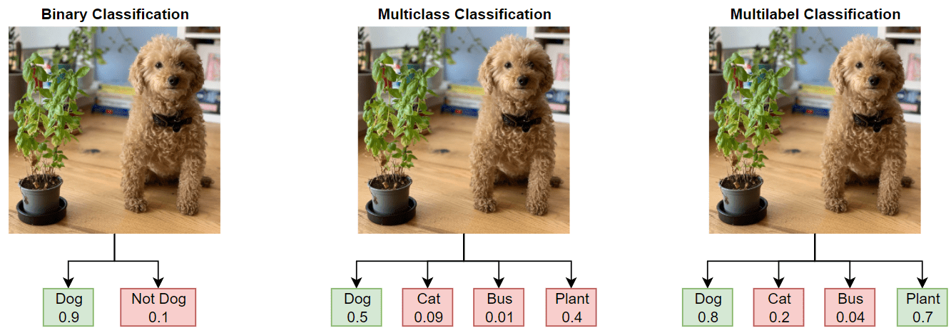
MULTI-LABEL CLASSIFICATION
Example: Assign multiple tags to images.
Assign multiple labels to each sample.
Possible Approaches | Chosen Methods & Significance
Binary Relevance MultiOutputClassifier (with RF, MLP) Label Powerset | Random Forest: Robust for multiple outputs. MLP: Captures complex, non-linear label relationships. Logistic Regression: Baseline for simpler problems.
Steps
Data Preparation: Normalize features. Model Training: Train MultiOutput models (RF, MLP, Logistic). Prediction: Predict multi-label outputs for test data. Formatting: Save results in required format.
Notes:
"Multi-label classification assigns multiple labels to each sample. A simple example is tagging an image with attributes like 'dog,' 'cat,' 'plant,' or 'bus.'"
"The diagram demonstrates the progression from binary classification to multi-class and multi-label classification, showing how an image can belong to multiple categories simultaneously."
"Some common approaches to solving multi-label problems include Binary Relevance, MultiOutputClassifier (used with methods like Random Forest or MLP), and Label Powerset.""For this project, I chose three methods:""Random Forest for its robustness in handling multiple outputs."
"MLP for capturing complex, non-linear label relationships."
"Logistic Regression as a baseline for simpler cases."
"The steps involved were:""Data Preparation: Normalize the features to ensure consistency."
"Model Training: Train MultiOutput models using Random Forest, MLP, and Logistic Regression."
"Prediction: Predict the multi-label outputs for test data."
"Formatting: Save the results in the required format for evaluation."

Slide 7
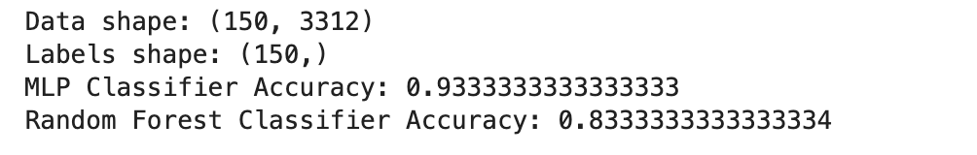
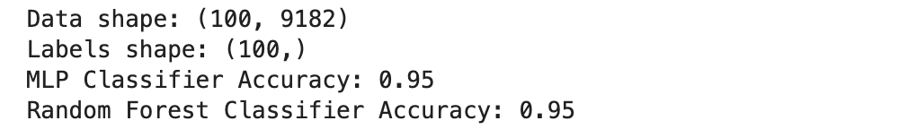
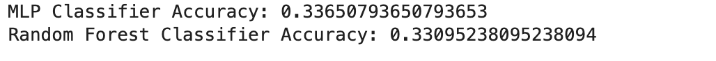
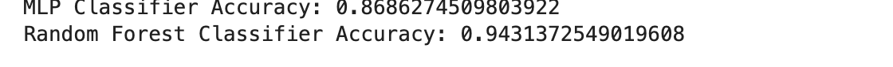
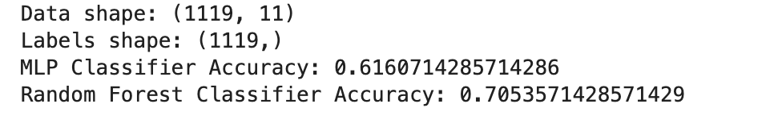
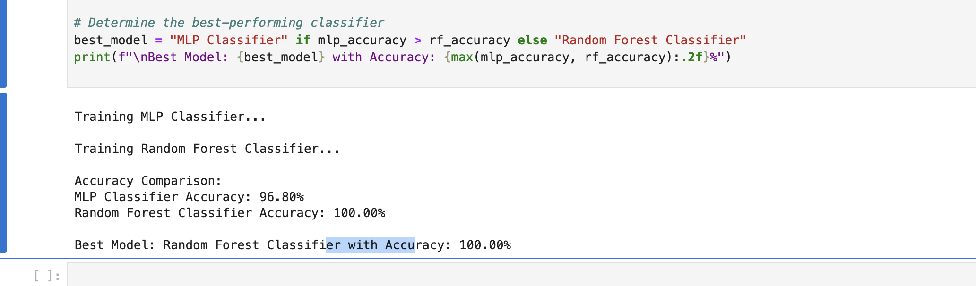
RESULTS
Problem | Results
Classification | Dataset1: MLP (93%), RF (83%) Dataset2: Both (95%) Dataset4: RF (94.3%) Dataset 3, 6: Neither optimal.
Missing Value Estimation | KNN produced more complete datasets compared to Mean Imputation for structured data.
Multi-Label Classification | Random Forest Training Accuracy: 100% MLP Training Accuracy: 93.7%.
Notes:
"Here are the results from each project, highlighting the performance of the chosen methods."Classification:"Dataset 1: MLP achieved 93%, outperforming Random Forest at 83%."
"Dataset 2: Both methods performed equally well with 95% accuracy."
"Dataset 4: Random Forest stood out with 94.3% accuracy."
"For Datasets 3 and 6, neither method performed optimally, indicating the need for further optimization."
Missing Value Estimation:"KNN Imputation produced more complete datasets compared to Mean Imputation, making it better for structured data."
Multi-Label Classification:"Random Forest achieved a perfect training accuracy of 100%."
"MLP followed closely with 93.7% training accuracy."
"The results validate the chosen methods while also pointing to areas for further improvement in some datasets."

Slide 8
OPTIMIZATIONS & PARAMETERS
Problem | Optimizations
Classification | Test Gradient Boosting for improved performance. Optimize learning rate (MLP) and number of trees (RF).
Missing Value Estimation | Explore MICE for advanced imputation. Optimize k in KNN (e.g., k=3, k=7).
Multi-Label Classification | Test Label Powerset for correlated labels. Optimize MLP parameters: hidden layers, batch size, epochs.
Learning Rate
Number of Trees (RF)
k (KNN)
Controls how much weights are adjusted with each iteration. Smaller values improve convergence.
Increasing trees captures more patterns but slows training.
Balances local versus global relationships in data.
KEY PARAMETERS
Notes:
"To improve the results, I’ve identified key optimization strategies for each problem."Classification:"Test Gradient Boosting as an alternative method for enhanced performance."
"Optimize learning rate for MLP and adjust the number of trees for Random Forest to capture more patterns."
Missing Value Estimation:"Explore MICE, an advanced imputation technique, for datasets with complex missing value structures."
"Experiment with different values of k in KNN, such as k=3 or k=7, to balance local and global relationships."
Multi-Label Classification:"Test Label Powerset for handling correlated labels effectively."
"Optimize MLP by tuning hidden layers, batch size,( and the number of epochs) to enhance accuracy."
"The key parameters for optimization include:""Learning Rate: Controls how weights are adjusted during training. Smaller values help achieve better convergence."
"Number of Trees (RF): Increasing trees improves pattern recognition but can slow down training."
"k (KNN): Determines how many neighbors influence the missing value estimation, balancing local and global insights."
"These optimizations will help refine the models and improve overall performance."

Slide 9




CODING TOOLS AND FRAMEWORKS
Tools/Libraries | Purpose
Jupyter Notebook | Interactive coding and visualization.
NumPy, Pandas | Data manipulation and processing.
scikit-learn | Model building, imputation, and evaluation.
Warnings Filter | Suppress irrelevant warnings for clean output.
Notes:
"Here are the primary tools and libraries used in this project to implement the solutions."
"I used Jupyter Notebook for interactive coding and visualization, which made it easy to iterate and debug."
"NumPy and Pandas were crucial for data manipulation and preprocessing, especially handling missing values and transforming datasets."
"scikit-learn was the core library for implementing machine learning models, imputations, and evaluation techniques."
"Lastly, I used a warnings filter to suppress irrelevant warnings, ensuring clean and readable output during execution."
"These tools collectively streamlined the development and testing process for all three projects."

Slide 10
CONCLUSION
Summary:
Successfully approached three problems:
Classification: Compared MLP and Random Forest for various datasets.
Missing Value Estimation: Evaluated KNN and Mean Imputation.
Multi-Label Classification: Tested Random Forest, MLP, and Logistic Regression.
Future Directions:
Continue testing Gradient Boosting, MICE, and Label Powerset.
Finalize models after tuning key parameters like learning rate, number of trees, and hidden layers.
Identified areas for further optimization and improvement.
Notes:
Summary:
"In this project, I successfully approached three machine learning problems:"
"For Classification, I compared MLP and Random Forest across various datasets, identifying strengths and limitations."
"In Missing Value Estimation, I evaluated KNN and Mean Imputation, noting that KNN provided more accurate imputations for structured datasets."
"For Multi-Label Classification, I tested Random Forest, MLP, and Logistic Regression, achieving strong results with Random Forest."
Future Directions:
"I have identified areas for further optimization and improvement."
"For example, I plan to continue testing advanced methods such as Gradient Boosting, MICE for Missing Value Estimation, and Label Powerset for Multi-Label Classification."
"Additionally, I will finalize models by tuning key parameters like learning rate, number of trees, and hidden layers to enhance accuracy and efficiency."

Slide 11

for your Attention!
Open to any Questions/Feedback you may have!
Email: nsakhamuri1@student.gsu.edu

